Slide 1

NI
Lecture
Networking Infrastructure
Dynamic Routing Protocols
4
Networking Infrastructure
Diploma in CSF / IT
Year 2 (2022/23), Semester 3
Notes:
Left-hand Bar – Replace FSP by your module code and X by the lecture number.
Replace Lecture Title
Replace < Module Name >
Replace Year and Semester if necessary

Slide 2
Dynamic Routing
Objectives
Explain the fundamentals of dynamic routing
Explain the routing information protocol (RIP) and OSPF
Understand the difference between Distance Vector Protocols (RIP) and Link State Protocols (OSPF)
Explain the advantages of dynamic routing over static routing
Configure dynamic routing protocol – RIP

Slide 3
Basics of Dynamic Routing
Two key dynamic routing protocols are Routing Information Protocol (RIP) and Open Shortest Path First (OSPF)
Dynamic routing protocols can be classified as distance vector (used by RIP) and link state (used by OSPF)
Notes:
RIP and OSPF two dynamic routing protocols

Slide 4
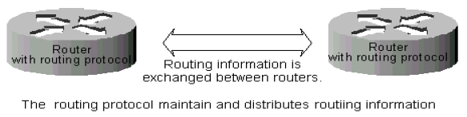
Basics of Dynamic Routing
Minimum configuration and set-up is required
Routes are automatically discovered and maintained by routers through the exchange of routing information between them
Routing decisions are made based on dynamically learned routes
Notes:
Min config is needed
Routers are automatically discovered and maintained by routers through sharing of routing information between them
Routers decisions are made based on dynamically learned routes

Slide 5
Distance Vector Protocol
Each router informs its neighbours of its entire routing table periodically
Routing information that is sent to its neighbours routers consists of destinations (vector) and costs (how far is the path to the destination?) and the next hop to get there
Router selects the neighbour advertising the lowest cost (least number of hops)
If router A learns that its neighbour, router B can get to router D in two hops, the router can assume that the path from itself to router D is three hops
Notes:
Shares entire routing table periodically for RIP it is once every 30 seconds
Routing information that is exchange consists of 1. Destination (vector) 2. Cost (distance) 3. Next hope to get to the destination
Router selects the route with the least advertised cost.
If a cost is 2 hops, then the router assumes it can get to the destination in 2 + 1 hops

Slide 6
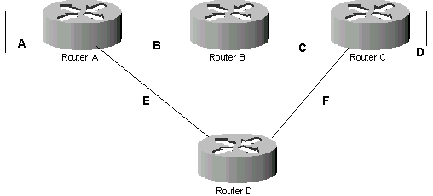
Dynamic Routing Activity
Network | Next Hop | Cost
Network | Next Hop | Cost
Network | Next Hop | Cost
Network | Next Hop | Cost
Notes:
Form 4 groups, each group is assigned a router
Each group will write on a piece of paper the routing table containing Destination Network, Next Hop Router, Cost (Number of hops) and Update#
Initial configuration – fill in the Network connected to each interface of the group’s router in the routing table
Update# 1 - each group will share their current table with their adjacent routers only. New Networks and Routers learnt on the first round, Update# is 1
Update# 2 - each group will share their current table with their adjacent routers only. New networks learnt on the second round, Update# is 2. For 2 routes to the same network, keep the route with the smaller update#.
Note: update process will repeat till every router knows every network.
What happens when 1 of the routes is broken?

Slide 7
Distance Vector Protocol - Initial
Network | Next Hop | Cost
A | Direct | 0
B | Direct | 0
E | Direct | 0
Network | Next Hop | Cost
B | Direct | 0
C | Direct | 0
Network | Next Hop | Cost
C | Direct | 0
D | Direct | 0
F | Direct | 0
Network | Next Hop | Cost
E | Direct | 0
F | Direct | 0

Slide 8
Distance Vector Protocol - Update 1
Network | Next Hop | Cost
A | Direct | 0
B | Direct | 0
E | Direct | 0
C | Router B | 1
F | Router D | 1
Network | Next Hop | Cost
B | Direct | 0
C | Direct | 0
A | Router A | 1
E | Router A | 1
D | Router C | 1
F | Router C | 1
Network | Next Hop | Cost
C | Direct | 0
D | Direct | 0
F | Direct | 0
B | Router B | 1
E | Router D | 1
Network | Next Hop | Cost
E | Direct | 0
F | Direct | 0
A | Router A | 1
B | Router A | 1
C | Router C | 1
D | Router C | 1
Notes:
For 2 routes to the same network, keep the route with the smaller update#.

Slide 9
Distance Vector Protocol - Update 2
Network | Next Hop | Cost
A | Direct | 0
B | Direct | 0
E | Direct | 0
C | Router B | 1
F | Router D | 1
D | Router B | 2
Network | Next Hop | Cost
B | Direct | 0
C | Direct | 0
A | Router A | 1
E | Router A | 1
D | Router C | 1
F | Router C | 1
Network | Next Hop | Cost
C | Direct | 0
D | Direct | 0
F | Direct | 0
B | Router B | 1
E | Router D | 1
A | Router B | 2
Network | Next Hop | Cost
E | Direct | 0
F | Direct | 0
A | Router A | 1
B | Router A | 1
C | Router C | 1
D | Router C | 1
Notes:
For 2 routes to the same network, keep the route with the smaller update#.

Slide 10
Distance Vector Protocol
Routers send out their own routing information to its neighbouring routers
Within a few minutes, all the routers would have exchanged the updated information and have a view of the network including all the routes
When all routers have a full view of the network the network is said to have “converged”
Notes:
Sends out routing information to its neighbouring routers.
After time, routers will exchange the updated information and have a view of the entire network (all routes)
Router having a full view of the network is said to have “converged”

Slide 11
Distance Vector Protocol - RIP
Routing Information Protocol
Uses hop count as its routing metric to determine the shortest route to the destination network
Does not take into consideration the speed, delay, and reliability
Maximum number of hops is 15
A route with a hop count of 16 is flagged as unreachable
Update its routing table to neighbours every 30 seconds. Generate a lot of overhead traffic
Notes:
Hop Count does not take into consideration the speed, load, reliability, or latency(delay) of any particular hop, but merely the total count.
Uses Bellman-Ford algorithm to determine the shortest path
Max hops is 15, > 15hop counts the route is said to be unreachables
Updates occur every 30 seconds. Generates a lot of overhead traffic
Does not account for speed delay or reliability merely looks at hop count to determine shortest route to the destination network.

Slide 12
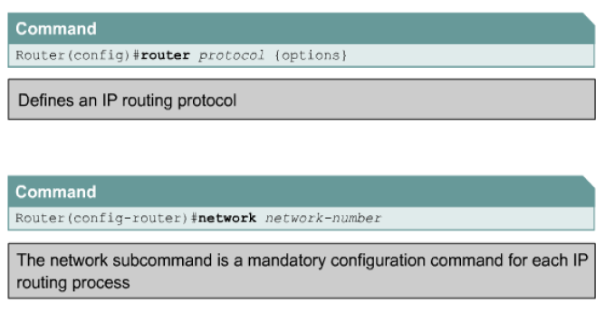
Router and Network Commands

Slide 13
Basic RIP Commands
Using router rip and network commands to Enable RIP on an IP-addressed network
Monitoring IP packet flow using the show ip protocols command
The show ip route command

Slide 14
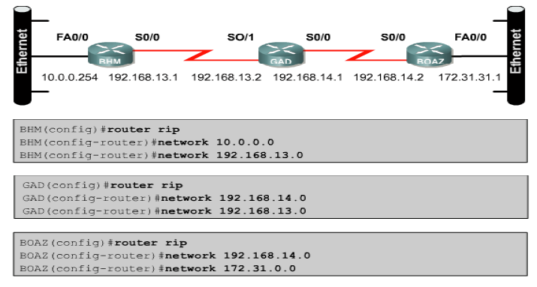
The Configuring RIP command

Slide 15
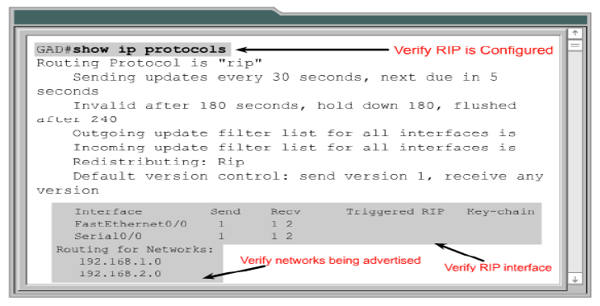
The show ip protocols command
Notes:
Used to see the protocols used for the router. Can verify networks which are dynamically configured and the type of protocol used

Slide 16
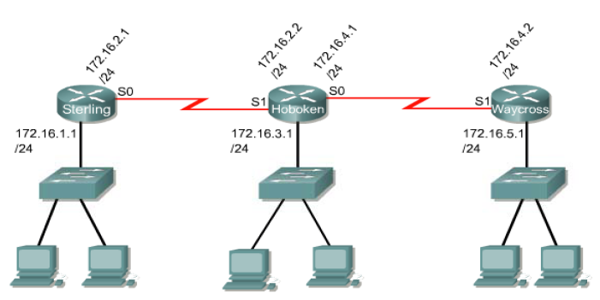
Sample Routed Network

Slide 17
The show ip route command
Sterling#sh ip route
Codes: C - connected, S - static, I - IGRP, R - RIP, M - mobile, B - BGP
D - EIGRP, EX - EIGRP external, O - OSPF, IA - OSPF inter area
N1 - OSPF NSSA external type 1, N2 - OSPF NSSA external type 2
E1 - OSPF external type 1, E2 - OSPF external type 2, E - EGP
i - IS-IS, L1 - IS-IS level-1, L2 - IS-IS level-2, ia - IS-IS inter area
* - candidate default, U - per-user static route, o - ODR
P - periodic downloaded static route
Gateway of last resort is not set
172.16.0.0/16 is subnetted, 5 subnets
C 172.16.1.0/24 is directly connected, FastEthernet0/0
C 172.16.2.0/24 is directly connected, Serial2/0
R 172.16.3.0/24 [120/1] via 172.16.2.2, Serial2/0
R 172.16.4.0/24 [120/1] via 172.16.2.2, Serial2/0
R 172.16.5.0/24 [120/2] via 172.16.2.2, Serial2/0
Note: Admin Distance for RIP is 120. 172.15.5.0 network is 2 hop counts away

Slide 18
Link State Protocol
A link state router will first discover who their neighbouring routers are and then start to exchange packets called Link State packets (LSP).
LSP contains information (state, attached interfaces, metrics) about the networks the router is directly connected to.
Require routers to send only updates (not entire routing table) to other routers when there are changes.
Compared with distance-vector:
Less bandwidth-intensive
Faster convergence time (react quickly to topology changes)
More CPU and memory resources required
Notes:
RIP vs OSPF: https://techdifferences.com/difference-between-rip-and-ospf.html
Exchange LSP with its neighbours (routers)
LSP contains info about the networks the router is directly connected to
Requires routers to send only updates (not entire routing table) to other routers when they are changes
Less bandwidth-intensive
Faster convergence time (reacts quicker to topology changes)
More CPU and memory resources required (disadvantage)

Slide 19
Link State Protocol - OSPF
Open Shortest Path First (OSPF) is a Link State Protocol
Uses a metric called cost to calculate optimal route to destination network. This cost metric is based on a variety of factors such as speed, reliability and delay.
A metric is a variable assigned to routes as a means of ranking them from most preferred to least preferred (hop count is a metric used by RIP)
Notes:
Metrics is a means of assigning routes from best to worst based on it.
OSPF is a Links State Protocol
Its metric is called costs and it takes into account variables such as speed, delay, reliability etc but not hop count which is the metric for RIP

Slide 20
Link State Protocol - OSPF
Factors used for calculating cost metric (routing metric):
Speed – refers to the speed of each link. Higher speed links have a lower cost than low speed links.
Delay – refers to the length of time required to move a packet from source to destination through the internetwork.
Reliability – refers to the dependability (usually described in terms of the bit-error rate) of each network link. Reliability of links in developed countries is usually higher than developing countries.
Notes:
Some of the factors used for calculating a routing metric are as follows: speed, reliability or latency(delay).
Speed = Speed of the network link. Higher speed = lower cost
Delay = Time to move a packet from source to destination over the internetwork. Lesser delay = Lower cost
Reliability = Dependability on the network link. Dev countries > developing countries. More reliability = lower cost
A full list of factors:.
•Hop count (used by RIP)
•Path speed
•Path reliability
•Latency (delay)
•Load
•Bandwidth
•Maximum transmission unit

Slide 21
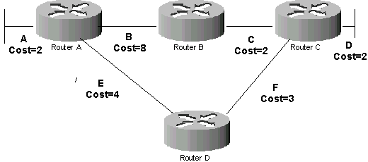

Link State Protocol - OSPF
Router A’s Routing Table

Slide 22
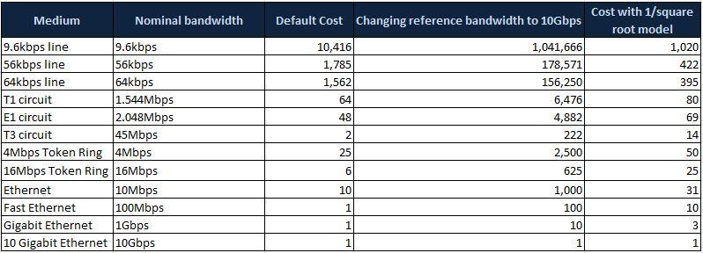
OSPF Default Cost

Slide 23
Benefits of Dynamic Routing
Simpler to configure routers on large networks
Routes are automatically discovered and maintained by routers, reducing administrative effort
Router can respond automatically to topology changes such as new or deleted routes (automatic re-routes enable network to be resilient)
Notes:
Simpler to configure on larger networks
Routers are automatically discovered and maintained. Reducing administrative effort
Routers can respond automatically to topology changes such as new or deleted routes. These automatic re-routes make a network resilient.

